Slide 1
virtual mode of 80386

Slide 2
In protected mode of operation, 80386DX provides a virtual 8086 operating environment to execute the 8086 programs.
The real mode can also use to execute the 8086 programs along with the capabilities of 80386, like protection and a few additional instructions.

Slide 3
Once the 80386 enters the protected mode from the real mode, it cannot return back to the real mode without a reset operation.
Thus, the virtual 8086 mode of operation of 80386, offers an advantage of executing 8086 programs while in protected mode.
V86 Mode is also known as Virtual Mode of 80386.

Slide 4
V86 Mode is a Dynamic Mode.
It can switch repeatedly & rapidly between V86 Mode & Protected Mode.
To execute an 8086 program, the CPU enters in V86 Mode from Protected Mode.
CPU Leaves V86 Mode and enters protected mode to continue executing a native 80386 program.

Slide 5
The address forming mechanism in virtual 8086 mode is exactly identical with that of 8086 real mode.
In virtual mode, 8086 can address 1MB of physical memory that may be anywhere in the 4GB address space of the protected mode of 80386.

Slide 6
Like 80386 real mode, the addresses in virtual 8086 mode lie within 1MB of memory.
In virtual mode, the paging mechanism and protection capabilities are available at the service of the programmers.

Slide 7
The virtual mode allows the multiprogramming of 8086 applications.
The virtual 8086 mode executes all the programs at privilege level 3. (to give protection)

Slide 8
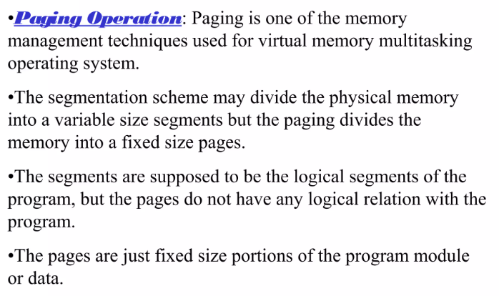
Paging

Slide 9
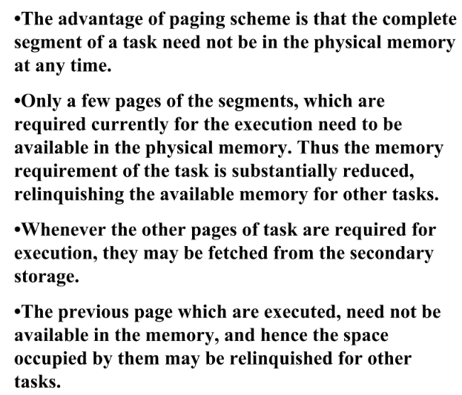

Slide 10
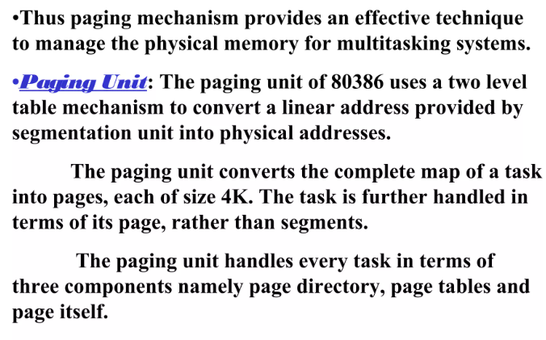

Slide 11
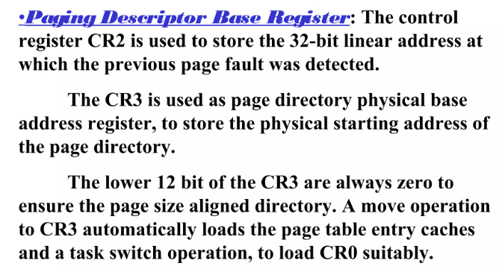

Slide 12
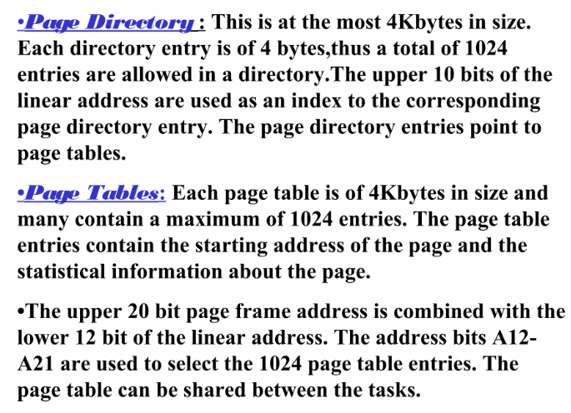

Slide 13
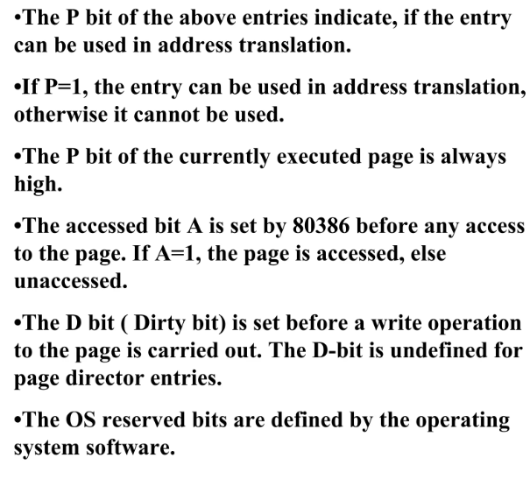

Slide 14
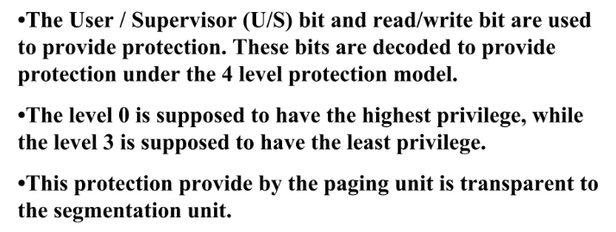

Slide 15
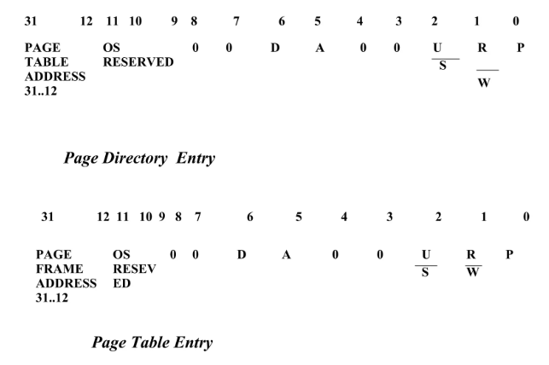

Slide 16
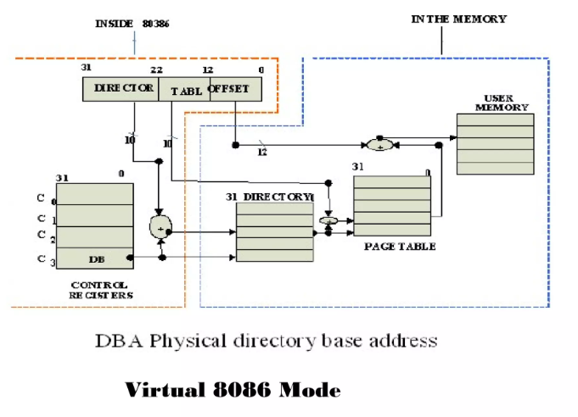

Slide 17
Page-mapping Tables
Our guest-task needs to use page-tables that the processor understands in 32-bit protected-mode (and Virtual-8086 mode)
For this we have several options
  Strict emulation of the 8086’s one-megabyte address-space will require us to construct a Page-Table and a Page-Directory
  Simpler solution, using Page-Size Extensions, would require only a Page-Directory table

Slide 18
Page-mapping alternatives
4MB
Scheme #1:
4KB
CR3
page
directory
page
table
page frames
Scheme #2:
CR3
page
directory
‘big’ page frame

Slide 19
Directory-entry formats
R (Reserved)
Without Pase-Size Extensions enabled in CR4 (PSE=0)
31 12 11 0
page-table frame number
0000 0000 0111
P (Present)
W (Writable)
U (User)
With Pase-Size Extensions enabled in CR4 (PSE=1)
31 22 21 12 11 0
‘big’ frame-number
0 0 0 0 0 0 0 0 0 0
0000 1000 0111
PS (Page-Size)
(1=4M, 0=4K)

Slide 20
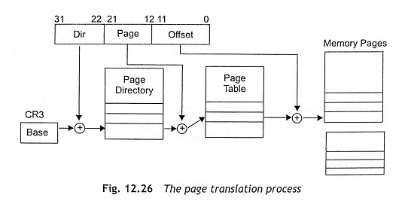
Page Tables and Directories

Slide 21
The linear address consists of the page directory entry, the page table entry and the page-offset address.
Figure 12.26 shows the page-translation process from linear address to physical address in memory pages.
The page directory has an array of 32-bit page-directory entries restricted in a 4 Kbyte page.
The maximum 1024 page-directory entries can be held in a page directory.
_x000b_

Slide 22
Page table is an array of 32-bit page-table entries restricted in a 4 Kbyte page.
About 1024 page-table entries can be held in a page table.
The page tables cannot be used for 2 Mbyte or 4 Mbyte pages.
The 2 Mbyte or 4 MByte page sizes are mapped directly from one or more page-directory entries.

Slide 23
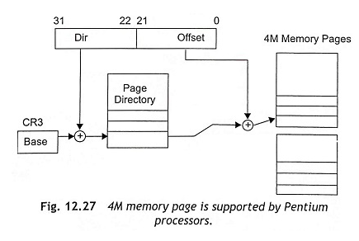

Slide 24
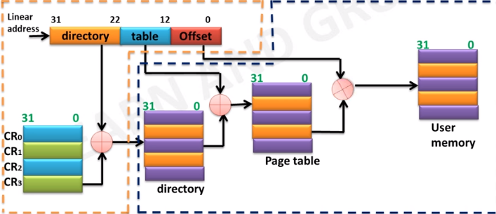

Slide 25
Usually the page directory is about 1K x 4 bytes or 4 Kbytes.
Each page table is also 4 Kbytes.
As there are 1024 (1K) possible page tables, a fully paged Pentium system requires 4 Mbytes + 4K to express the pag­ing.
But most of the operating systems do not use a fully paged memory system.
Pentium processors support the 4M paging.

Slide 26
When the Pentium processor supports 4M paging, there is no need of page tables and the page directory can be used to addresses a 4 Mbyte memory page.
Figure 12.27 shows the 4M memory page supported by Pentium processors.

Slide 27
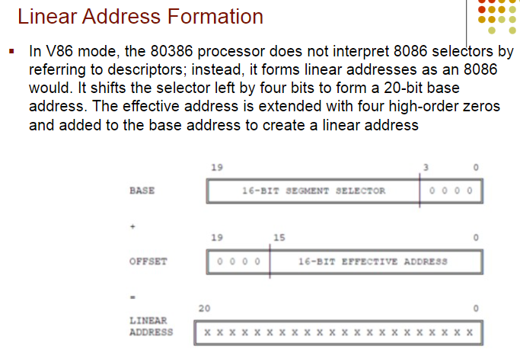

Slide 28
Summary
Step-by-step approach focuses first on the Virtual Machine guest-task
We need these guest data-structures:
    A Page-Directory table
    A Task-State Segment
    A GDT and an IDT (and maybe an LDT)
    A ring-3 stack-area and a ring-0 stack-area
We need these executable procedures:
    The guest-task’s ring-3 routine (.code16)
    The guest-task’s fault-handler (.code32)

